Slide 1



Making The Perfect Connection

Slide 2


Introduction
Protectron Electromech (P) ltd
Protectron was founded in 1972.
The Protectron team possesses over 30 years of rich experience across diverse sectors including Telecom, Automotive, Medical, Lighting, Defense, Domestic Appliances, and White Goods. The technology-focused team is dedicated to providing customers with high-quality and value-oriented solutions.
Protectron Electromech specializes in producing high-quality circuit protection fuses, interconnect solutions, EMI/RFI shielding products, EV connectors, airborne connectors, and EV cable assemblies.
Its capacity to meet large and small requirements in short duration has procured it over 350 satisfied customers. Additionally, our workforce comprises more than 100 employees.
01
02
03
04
Manufacturer of Professional Grade Components
Design, Development & Manufacturing
Wide Industry Expertise
Customized Solutions

Slide 3







INFRASTRUCTURE
Our company boasts an infrastructure spanning 50,000 square feet, supported by a workforce of over 100 employees, featuring fully automated German production machinery as well as a combination of full/semi-automatic Taiwanese machines and Japanese wire processing equipment, all integrated within a comprehensive ERP system.
50,000 Sq. Ft Production Area
100+ Employees
Fully Automatic German Production Equipment
Full/Semi-Automatic Taiwanese Machines
Japanese Wire Processing Machines
All Inclusive ERP System

Slide 4


Awards, Certifications & New Introductions
1977-2003
1977 Award from the President of India for Import Substitution of Fuses
1980 LCSO / DGQA (Defense) Approval
1994 Formation of Radiall Protectron (JV)
2000 Obtained ISO 9001:1994 Certification
2002 Obtained UL Certification of Compliance for Fuses
2003 Obtained LCSO approval for Connectors
2003 Obtained ISO 9001:2000 Certification
2007-2014
2007 Obtained approval under CACT-Approved Vendor Scheme
2009 Certifications for TS 16949:2002,ISO 14001:2004, ISO 9001:2008
2009 UL & ARAI Approvals for Midi Blade Fuse. ARAI Approval for Glass Fuses
2011 Capacity Expansion for Blade Fuses
2012 Introduction of Cable Assemblies
2013 UL Approval for Mini Blade fuse
2013 ARAI Approval for Mini Blade Fuse
2014 MIDI Bolt Down Fuse (32V) launched

Slide 5


2015-2022
2015 UL approval for complete series of Midi Blade fuse in PC & Nylon (2A to 40A). 2015 UL approval for TE Fuse.
2017 Certifications revised to ISO9001:2015, ISO14001: 2015 and IATF 16946:2016. 2018 Introduction of LP Mini Blade Fuse, Micro2 fuse, EV Charging Connector.
2018 UL approval for 300V TE fuse, UL approval for LP Mini Under Process. 2019 Design & supply of Special connectors for EVM project to BEL & ECIL. 2021 Design & development of Nickel Feeder /Bus bar connectors for EV’s.
2021 Introduction of Mega Bolt down fuses & Midi bolt down fuses(70V).
2022 UL lab approved and UL approval of Midi &Mega Bolt down fuse(70V) initiated. 2022 Machines incorporated, and New Protectron Unit established.
2023 We obtained UL lab approval and UL approval of Midi &Mega Bolt down fuse(70V).
2024 Fully Automated Machines Implemented for Midi Bolt Down Fuse (70V) & for Mega Bolt Down Fuse fully Automated Machines are initiated.

Slide 6

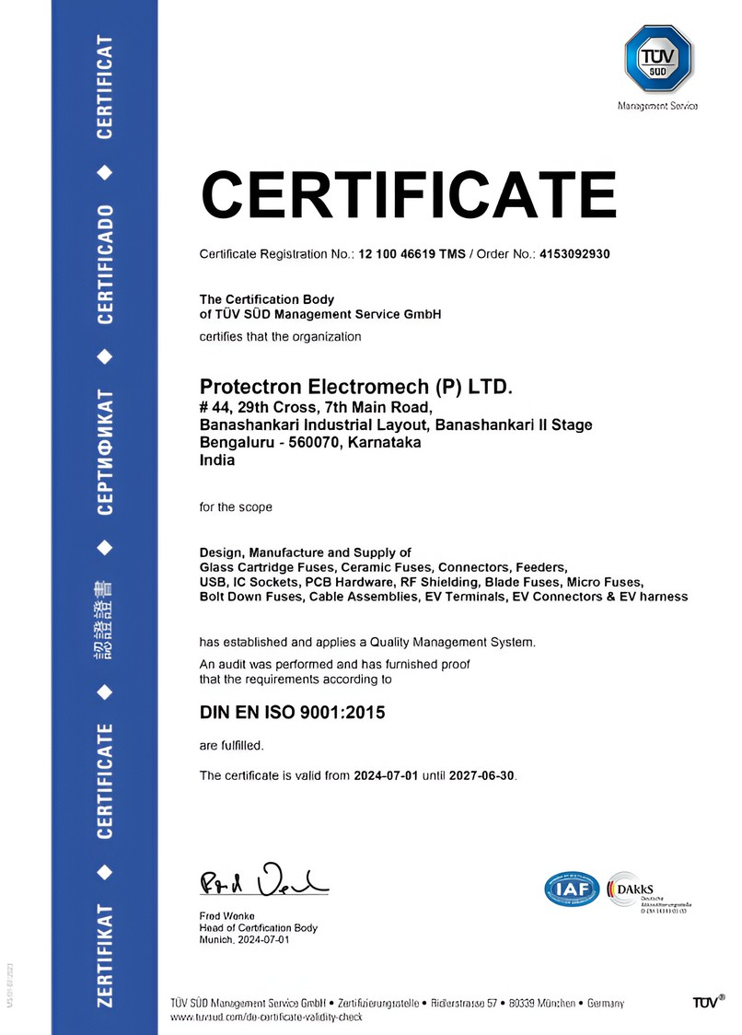
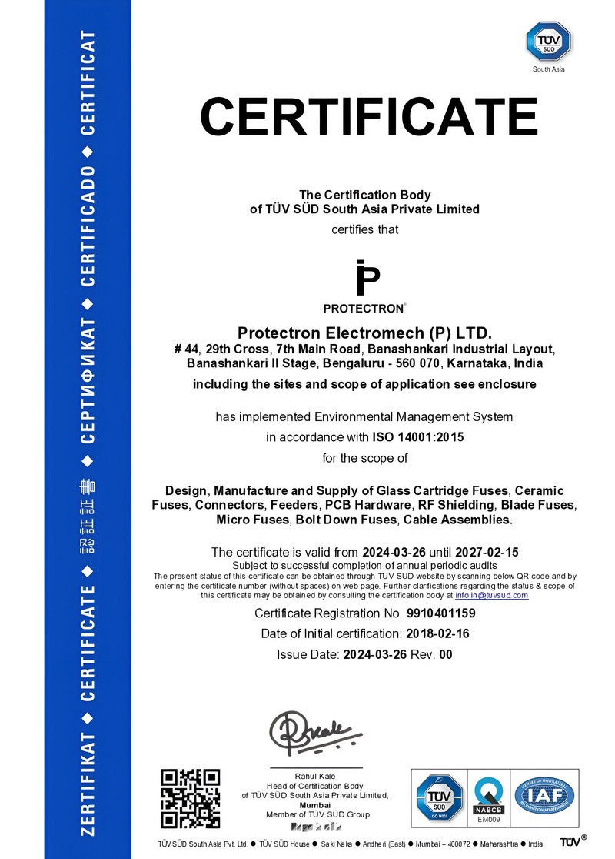
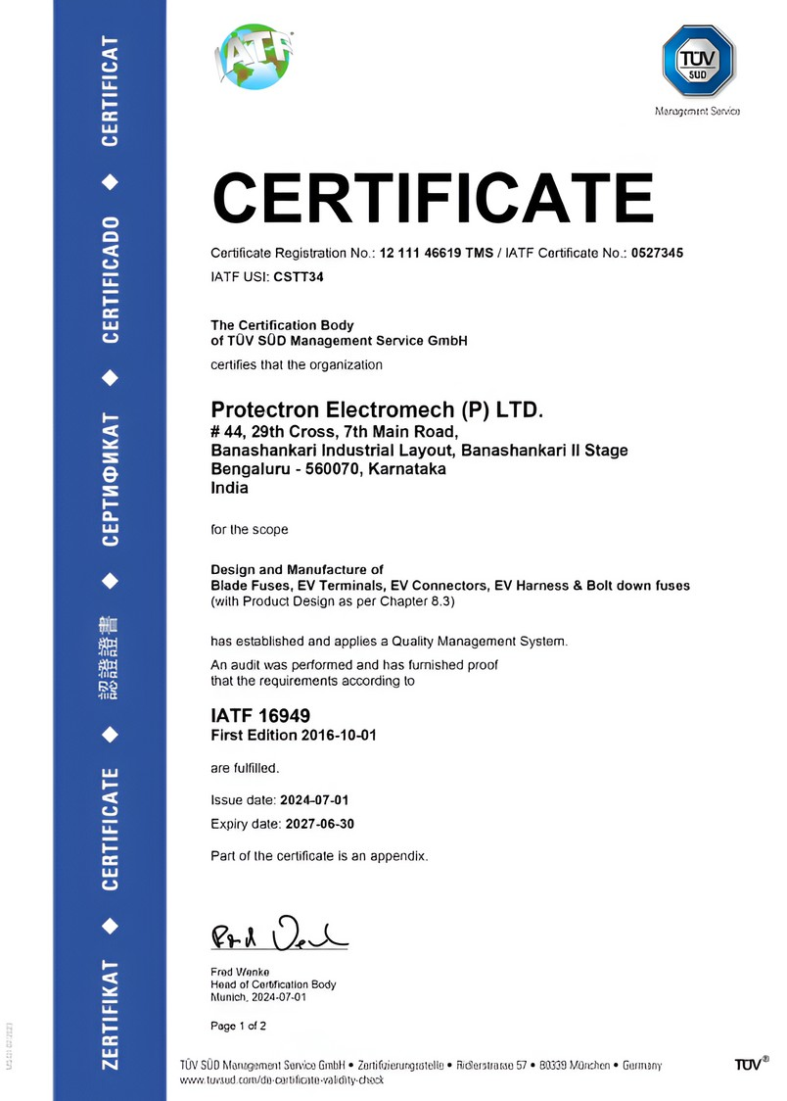
Quality Systems App rovals

Slide 7
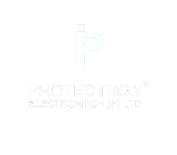


Product App rovals
Fuses:- UL , RoHS , ARAI & LCSO
Connectors:- RoHS , LCSO
App roved Current Ratings
ARAI Approved MIDI Blade Fuses (CURRENT RATING) 3A, 5A, 7.5A,10A, 15A, 20A, 25A,
30A, 40A
ARAI Approved MINI Blade Fuse (CURRENT RATING) 5A,10A,15A, 30A & 5A-N,10A- N,15A-N, 30A-N
ARAI Approved GLASS Fuses (CURRENT RATING)
5A &15A 32V

Slide 8

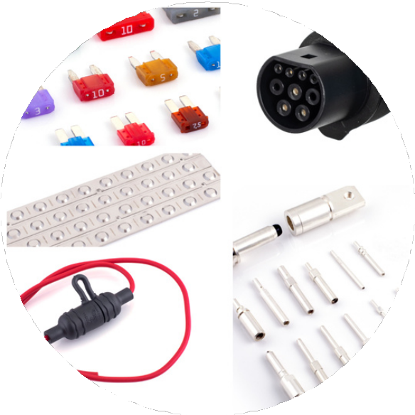
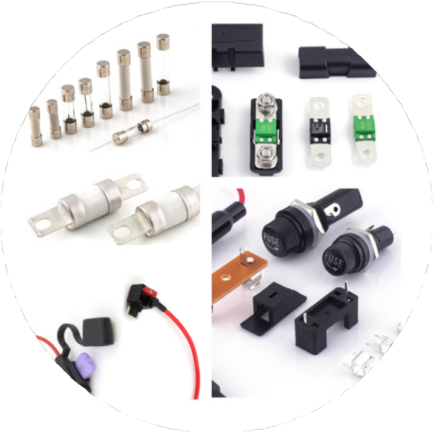
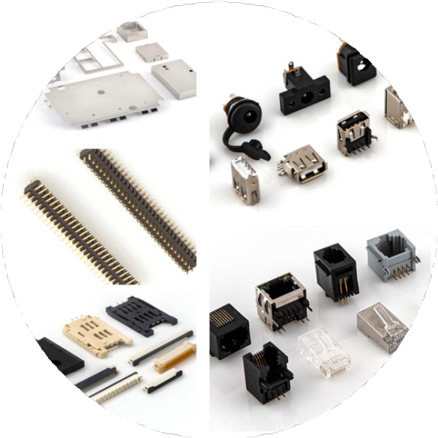
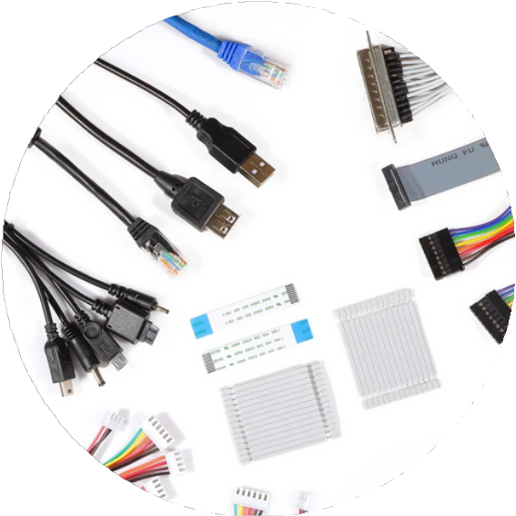
Protectron Products
Electric Vehicle Products
Circuit Protection Devices
Electronic Hardware
Cable Assembly
Automotive Fuse
In Line Fuse Holder
EV Charging Connector Bus Bar
EV Charging Terminals
EV Fuse
Glass & Ceramic Fuse Bolt down Fuse
Fuse Holders & Clips
Fuse Taps
RF Shields
USB 2.0 Connectors
Mother Board To Daughter Board Connectors
Modular Jacks FPC & Sim Cards
D- SUB Assembly RJ 11 and RJ 45
Assembly
IDC Cable Assembly Multiport
Wire to Board

Slide 9
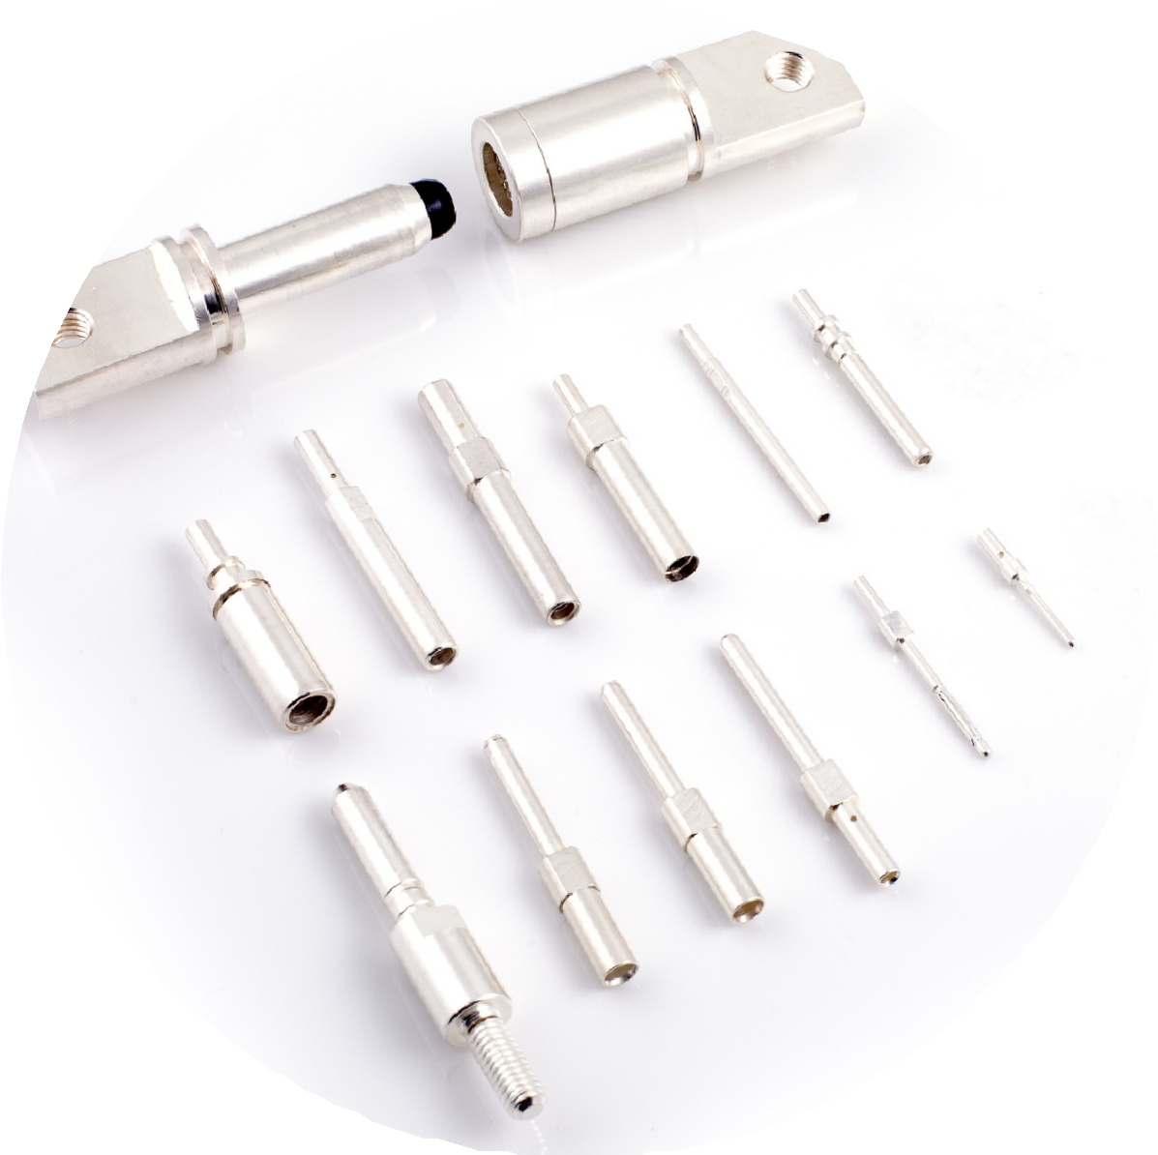
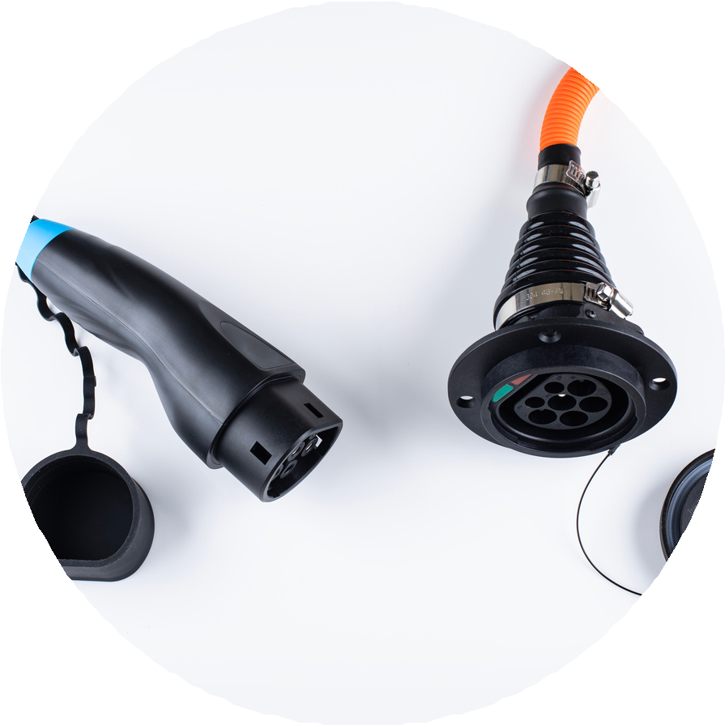
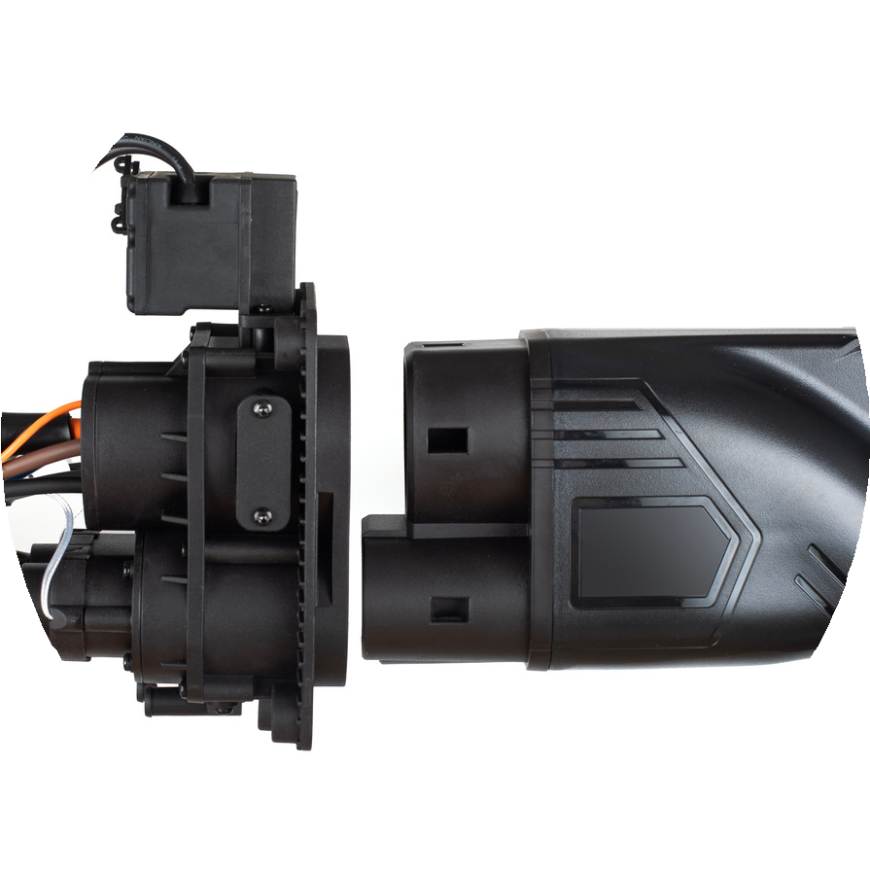
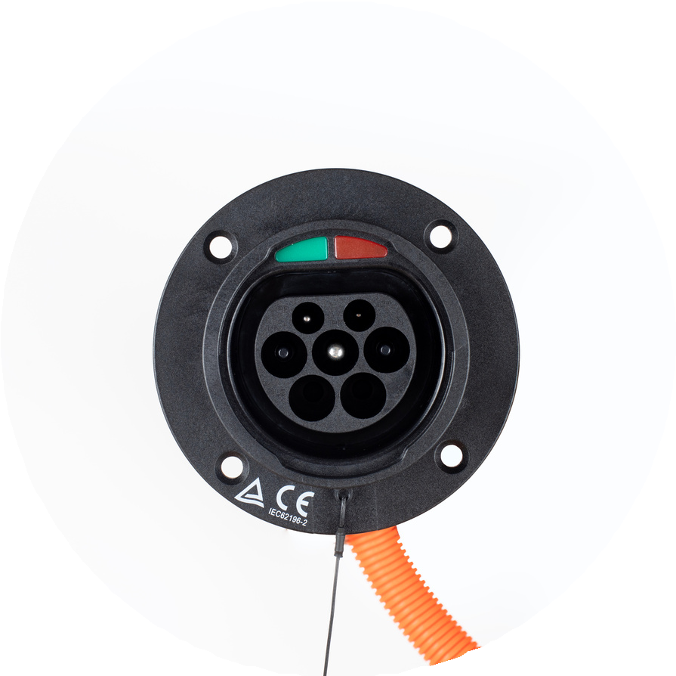
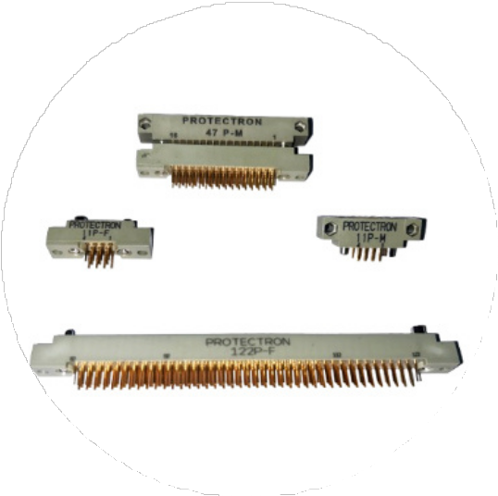
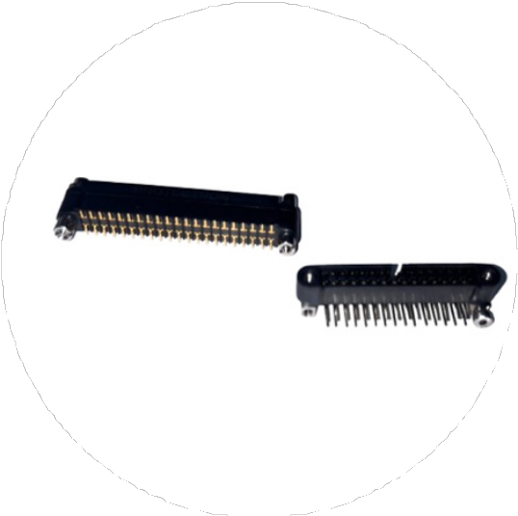
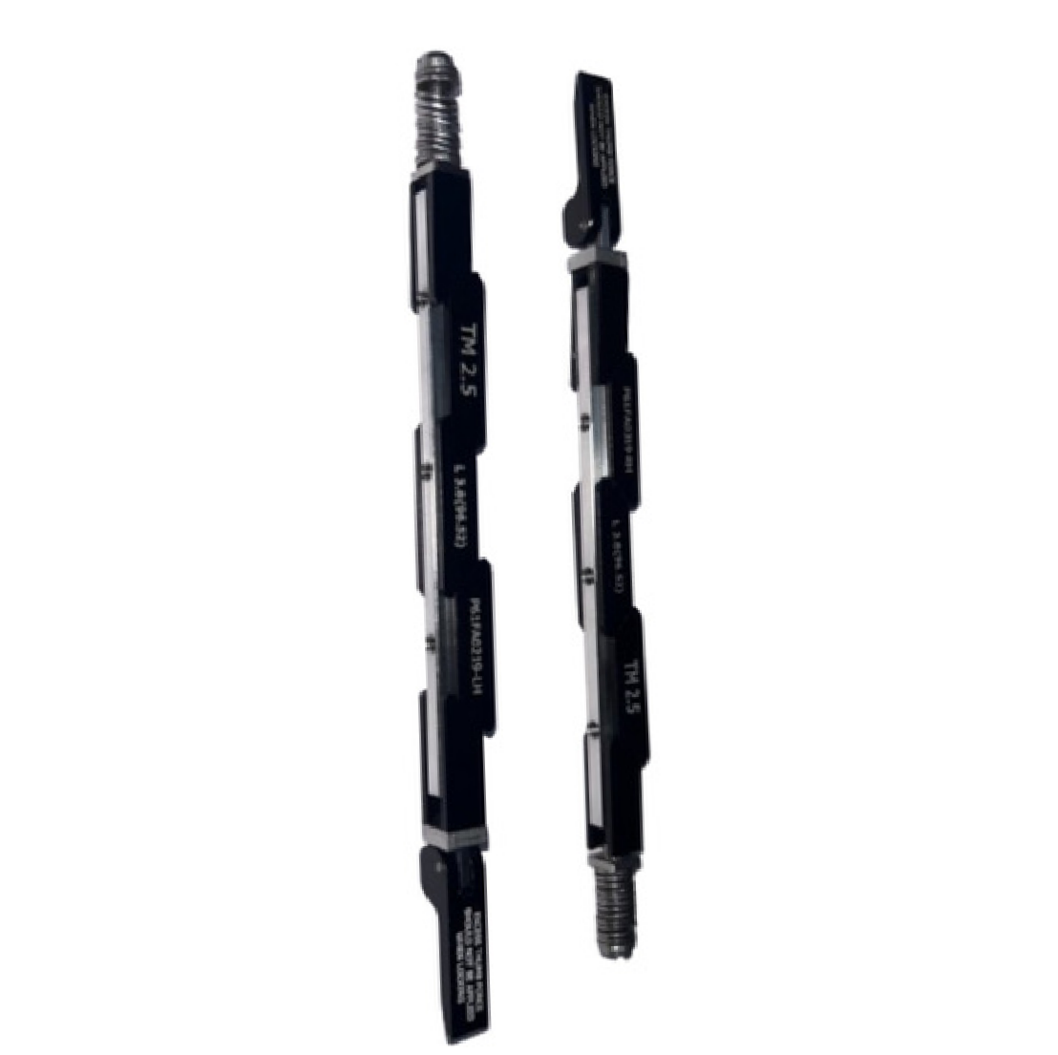

New Launched Products
EV Charging Terminals & Connectors
New Launched Products for Defence

Slide 10

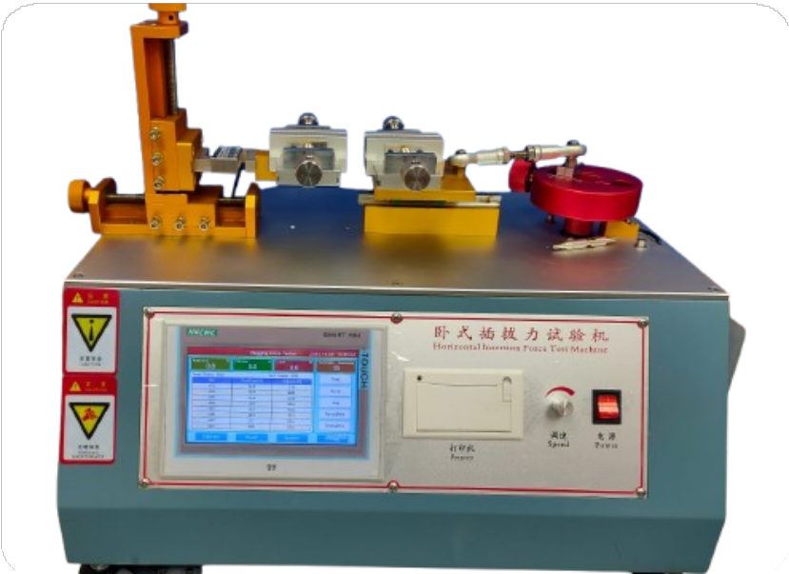
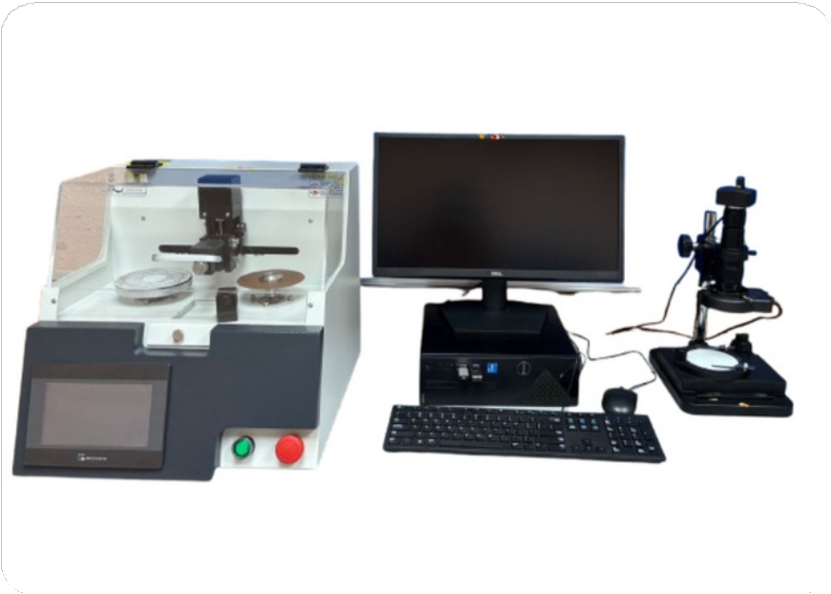
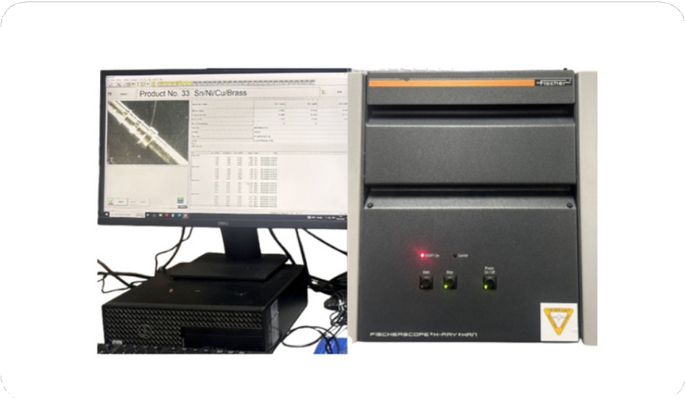
Quality Control
Testing Facilities Accessible.
2. Reliability Lab Facility: Mating Cycle Test Flammability Test
Salt Spray Testor Hot, Cold & Chamber
Humidity Chamber (40° to 180°) Thermal Chamber (till 200°) Crimped Profile Analyzer
1. full-fledged UL approval lab facility. (Standard Test Conducted as per UL 248 / UL 275A)
Time Current Characteristics up to 3000A. DC Interrupt Testing Facility up to 1000A. AC Interrupt Facility up to 120A.
Crimped Strength Test. Surge Test 7KVA. Transient Facility.
3. Other lab Facility:
Hardness Tester.
Video measurement System. XRF Plating thickness tester.
Crimp Strength tester for Wire Harness. 100%Continuity Tester for wire Harness. Insertion/ Extraction tester for Connectors. Camera inspection System for Wire Harness, Connector, Fuses.

Slide 11


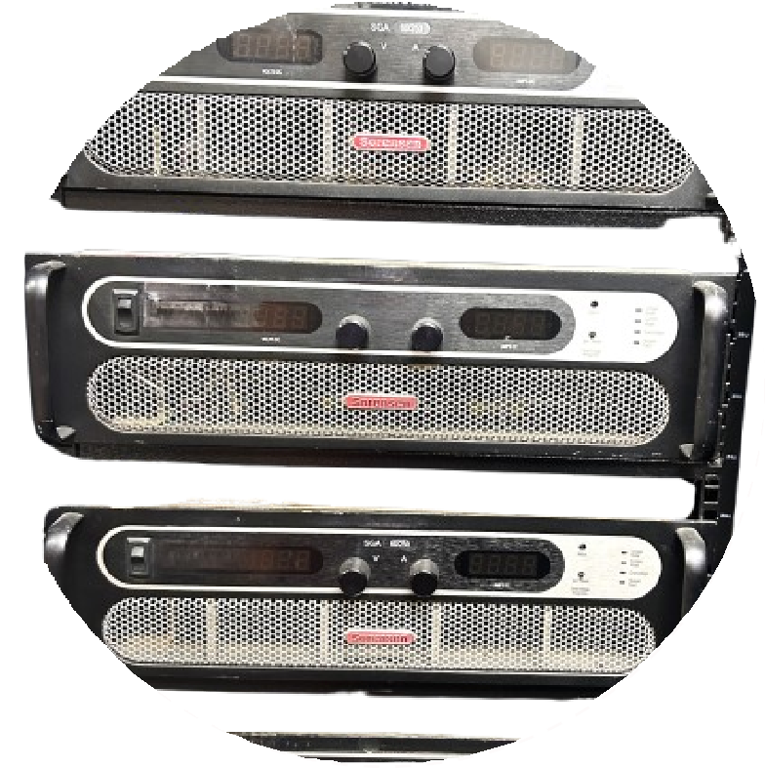
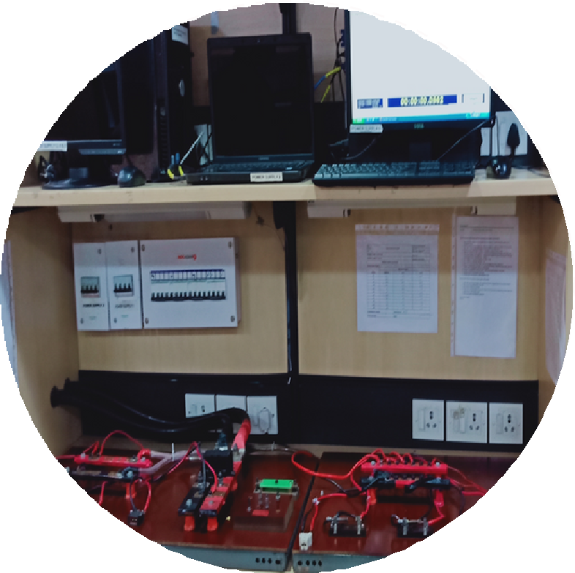
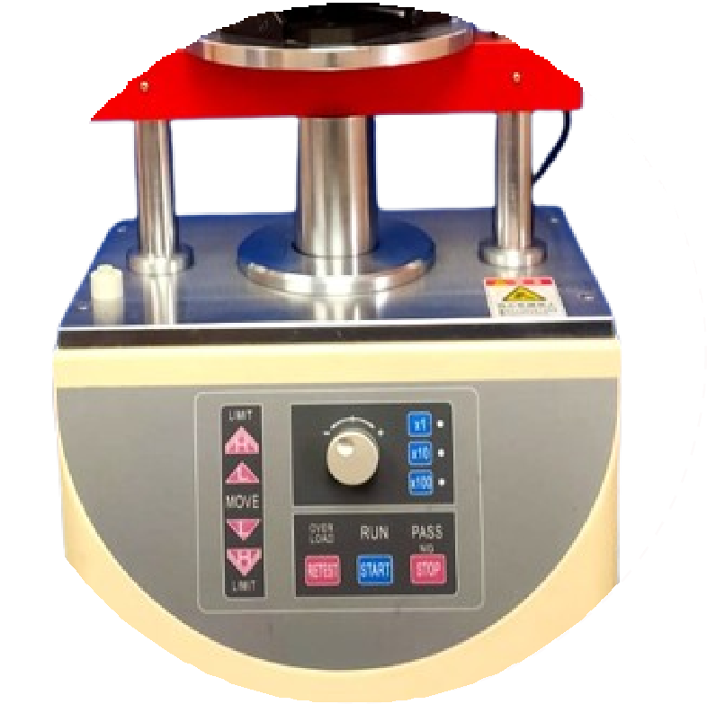
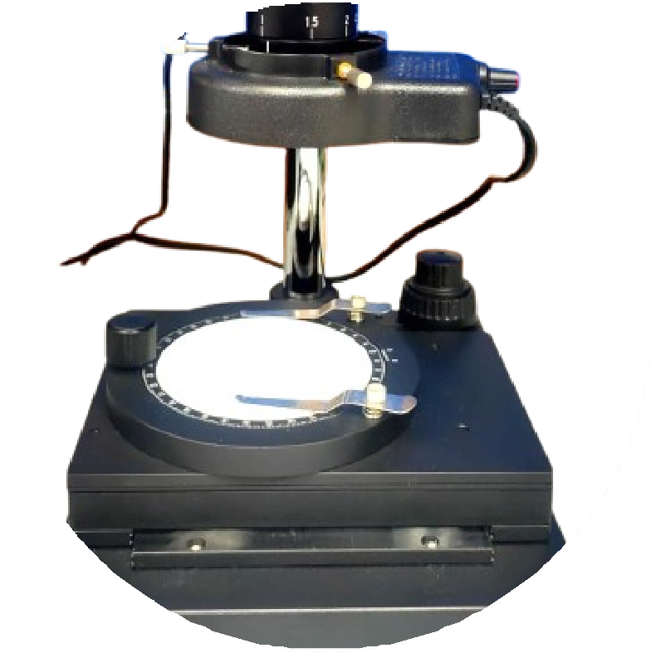
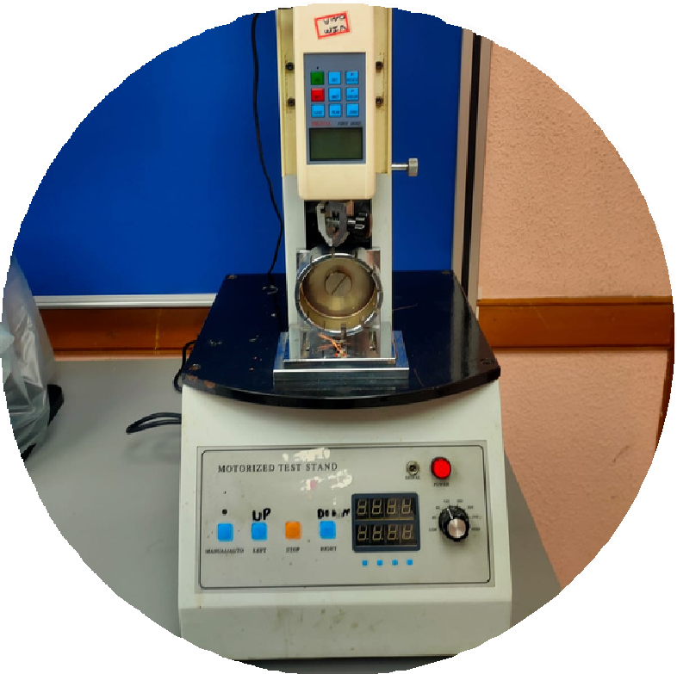
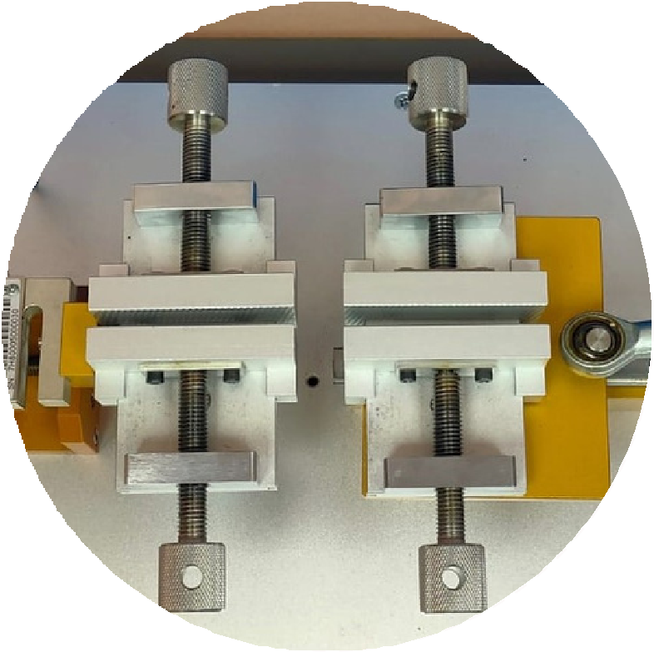
Quality Control Machines
Fuse Testing Power Supply
Fuse Testing Jigs
Insertion & Extraction Machine
Crimp Profile Analyser’s Microscope.
Pull of Load
Mating Cycle

Slide 12
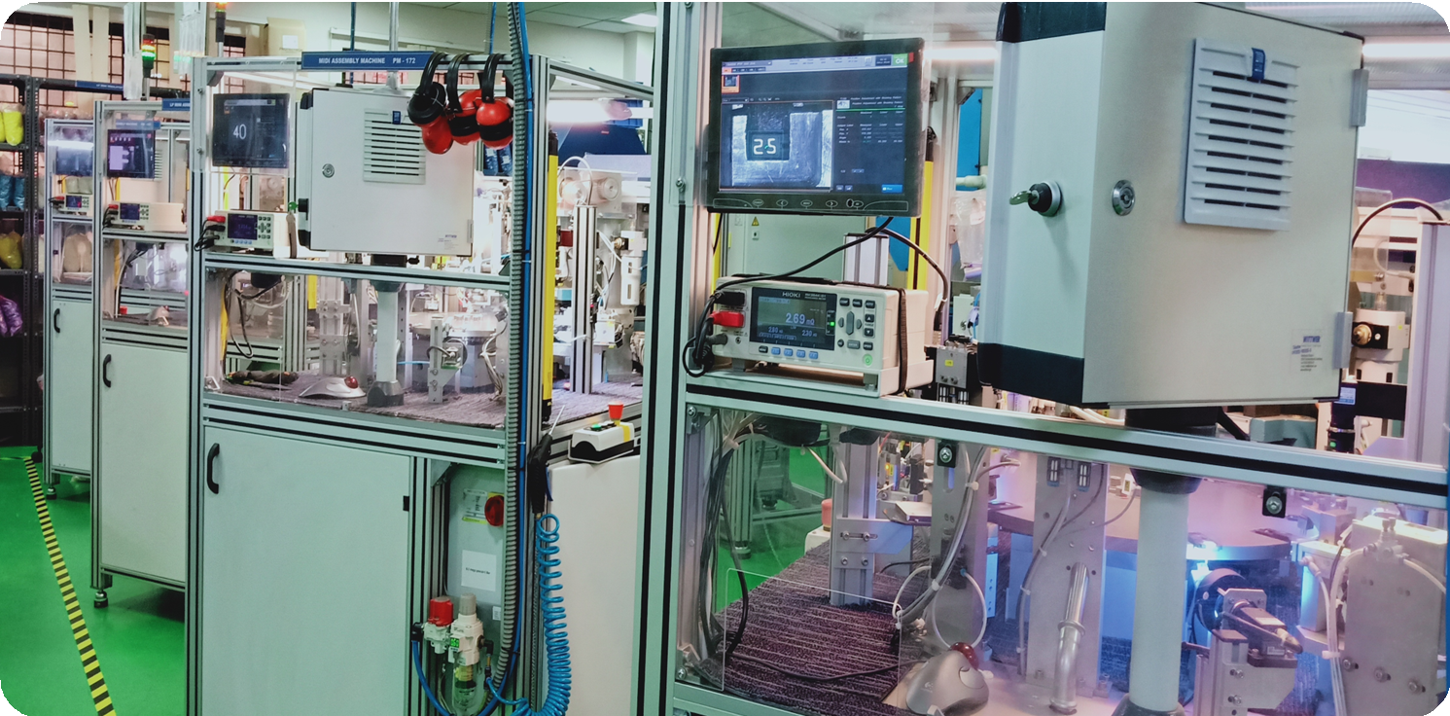
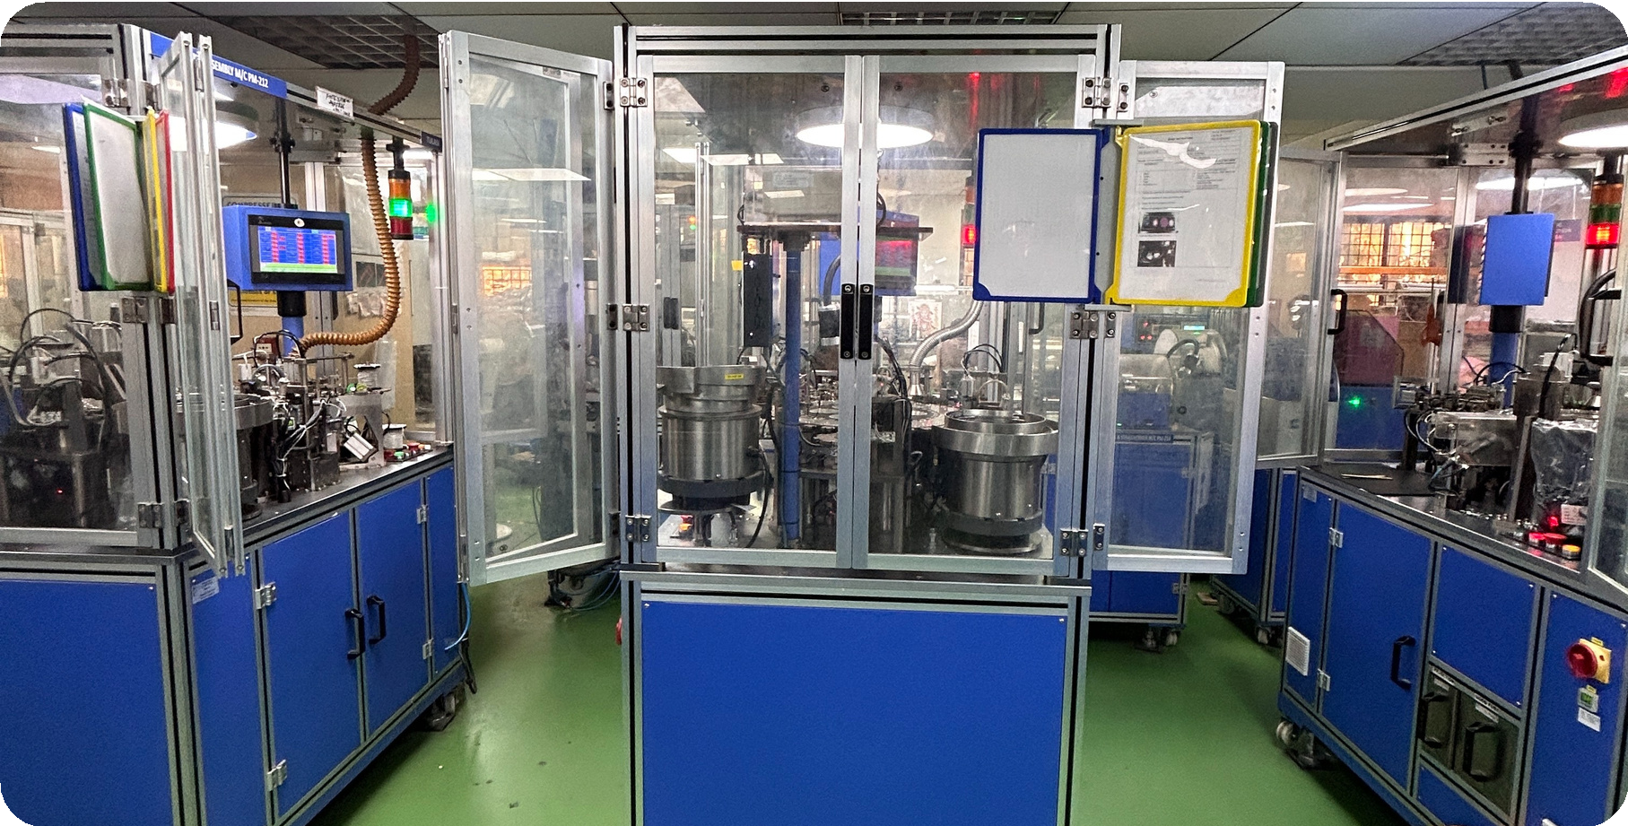
Blade Fuse Machine
These machines automate the production of blade fuses, ensuring precision and consistency in the manufacturing process. They handle tasks such as cutting, shaping, and assembling the metal blades and plastic housings.
TE Fuse Machine
TE focuses on innovation and efficiency in their products. Their machines are designed to streamline production processes, reduce errors, and increase overall productivity. This makes them a preferred choice for manufacturers looking to enhance their production capabilities.

Slide 13
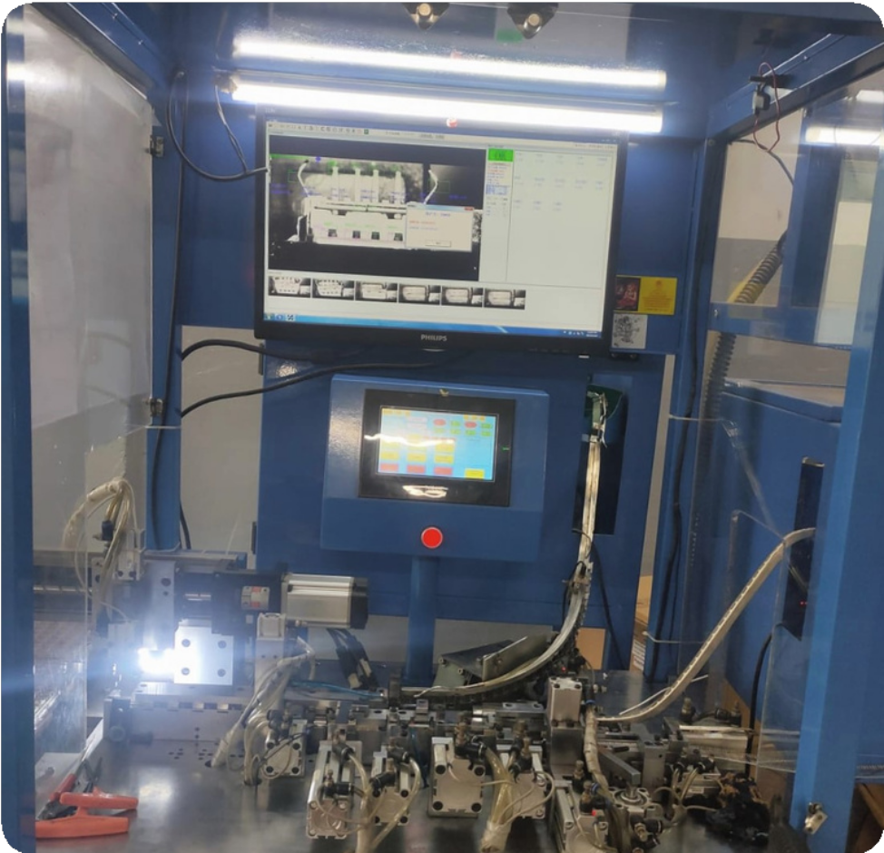
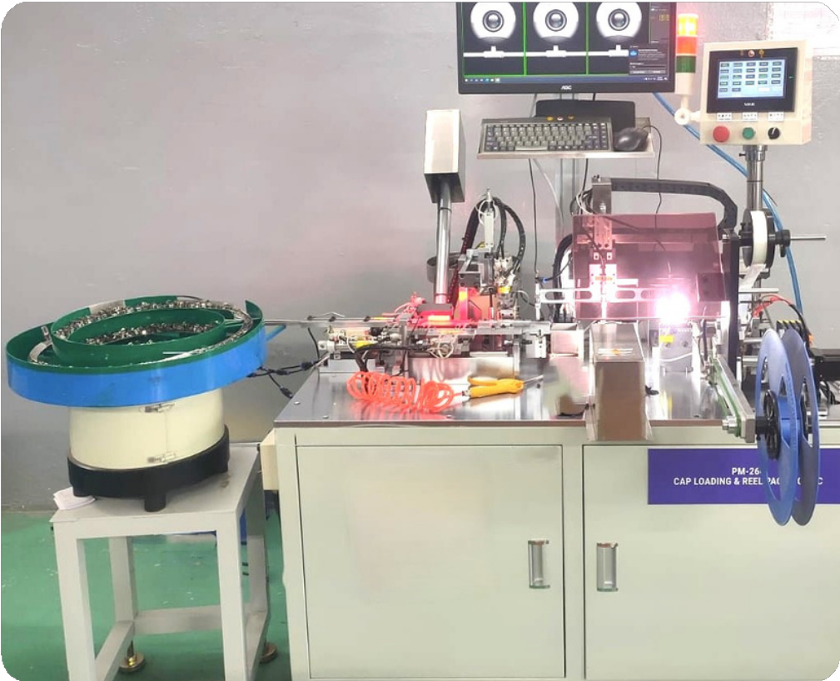
USB Connectors Machine
Facilitating the integration of USB connectors into various products, enhancing their functionality and user experience. Producing connectors that withstand frequent use and harsh environments, ensuring long-term reliability and performance.
IC Socket machine
Producing IC sockets for mounting integrated circuits on printed circuit boards (PCBs). Facilitates easy replacement and testing of ICs, enhancing the flexibility and maintenance of electronic devices.

Slide 14

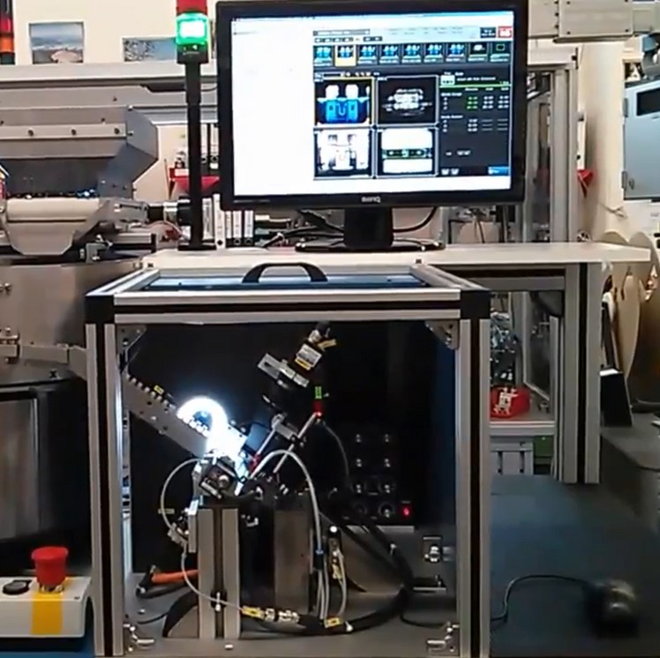
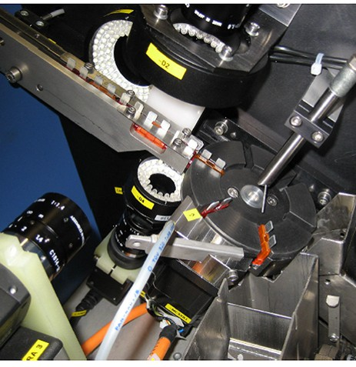
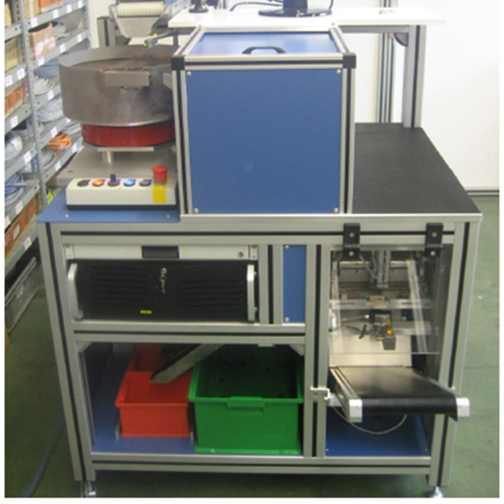
Vision Inspection System for Blade Fuse.

Slide 15

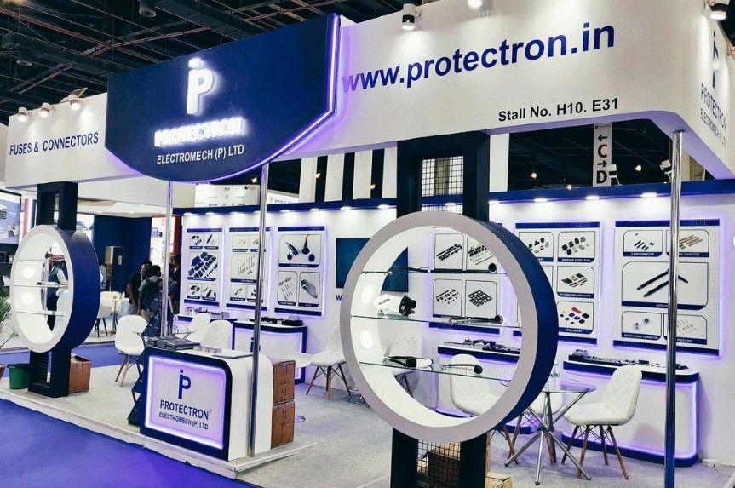
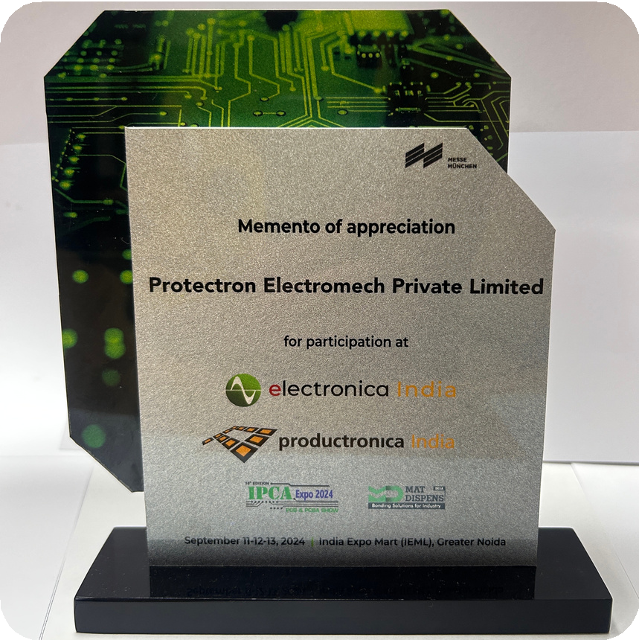
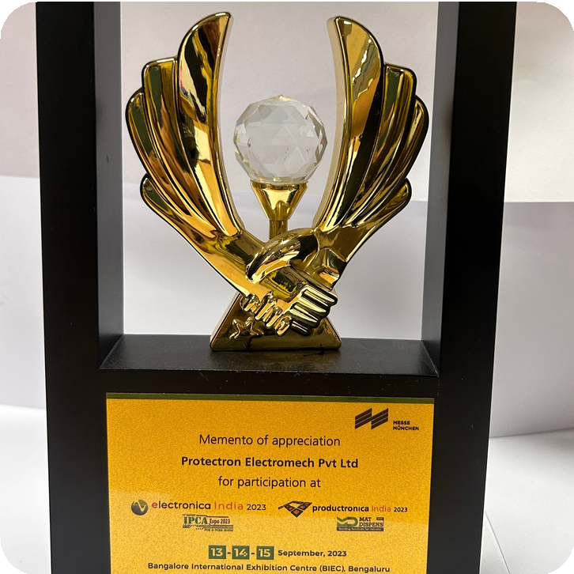
Electronica India 2023 & 2024
Participation Awards
India Exposition Mart Limited (IEML), Greater Noida, Delhi NCR

Slide 16











Major Customers in India
Automotive OEMs Tier-2

Slide 17










Our Major Customers in India
CMS Customers
Industrial Customers

Slide 18

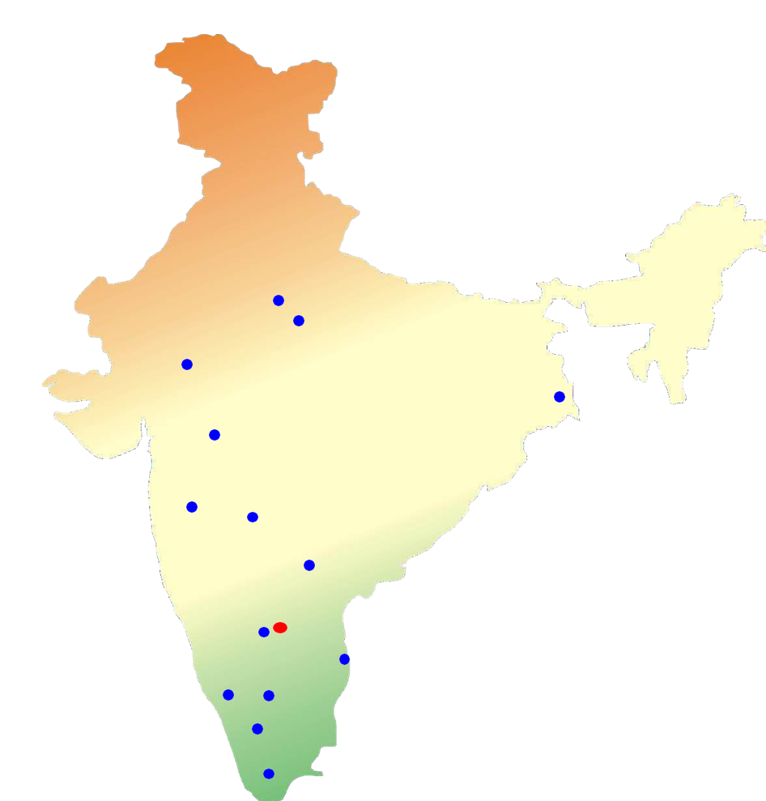



Our Distribution Network in India
Dealer Network
Manufacturing Plant
Bangalore

Slide 19

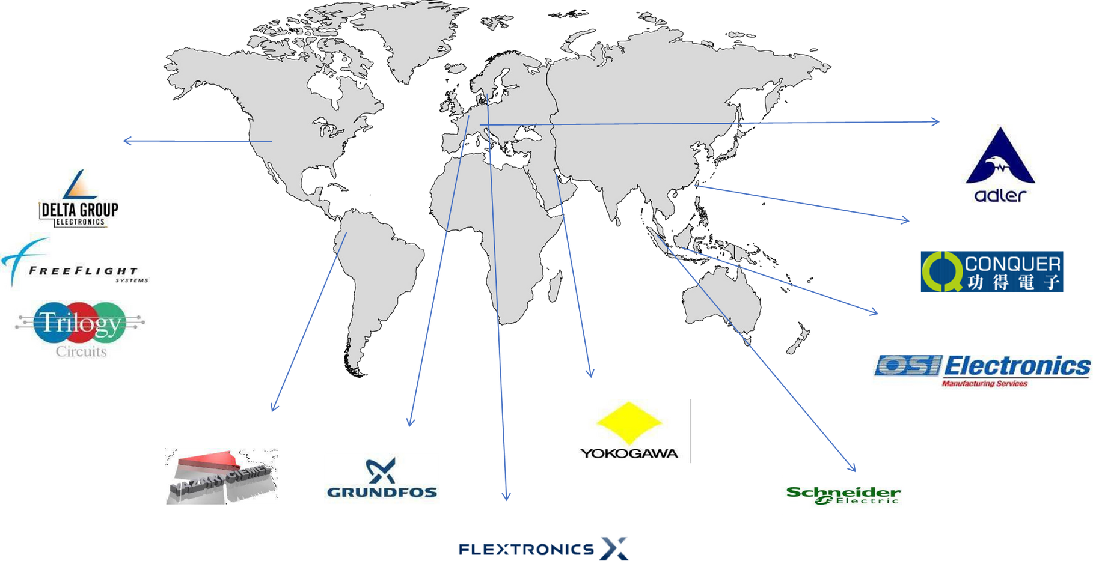

Our export- customers

Slide 20

Why Protectron?
30 Years in Manufacturing
International Raw Material Supplier Strong Quality System and Design Team Approvals and Certifications
Continuous Improvement and Automation Brand Image and Infrastructure Localization and Competitive Pricing Capacity and Customer Satisfaction
Benefits of working with us

Slide 21










Follow us for exclusive updates on all major social media platforms.

Slide 22



Thank You!
Contact Us
Phone
+91-80- 26716005
Mail
protectron@protectron.in
Website
www.protectron.in
Address
#44,29th Cross,7th Main Road, Industrial Layout, Banashankari 2nd Stage, Bengaluru 560070 Karnataka, India

